Slide 1

Module III : Software Review and Testing Q-n-A
Software Engineering (SE) → CSEN3202 – CSE/Btech/6th Semester → Module-III → Prepared by : Nilina Bera, CSE, HITK

Slide 2
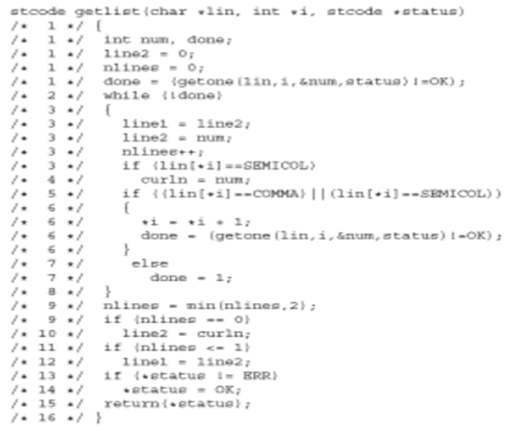
Nilina Bera

Slide 3

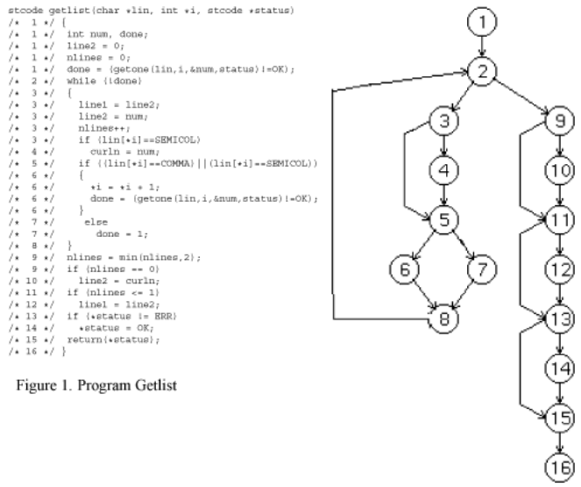
Cyclomatic Complexity Measures
E = 21, n = 16, cc = e – n + 2 = 21 – 16 + 2 = 7; Regions ➔ 7
Nilina Bera

Slide 4
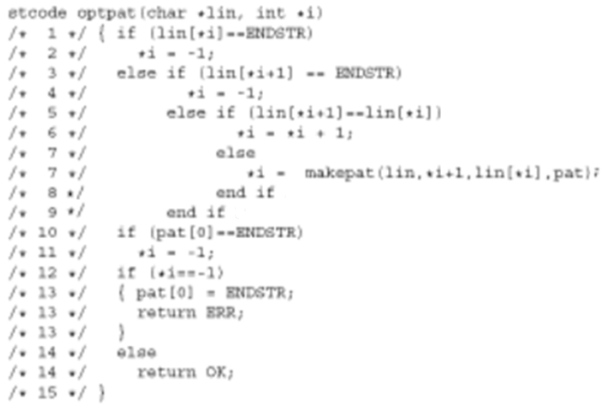
Nilina Bera

Slide 5
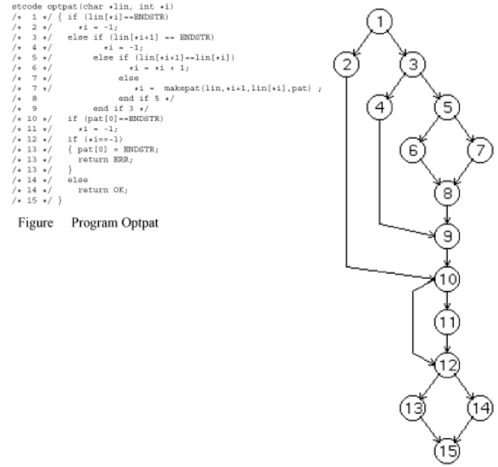
Cyclomatic Complexity Measures
E = 19, n = 15, cc = e – n + 2 = 19 – 15 + 2 = 6; Regions ➔ 6
Nilina Bera

Slide 6
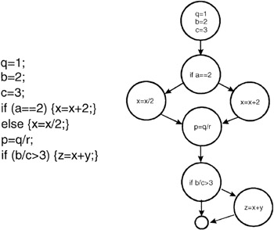
Cyclomatic Complexity Measures
E = 9, n = 8, cc = e – n + 2 = 9 – 8 + 2 = 3; Regions ➔ 3
Nilina Bera

Slide 7
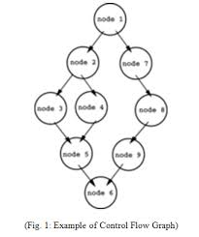
Cyclomatic Complexity Measures
E = 10, n = 9, cc = e – n + 2 = 10 – 9 + 2 = 3; Regions ➔ 3
Nilina Bera

Slide 8
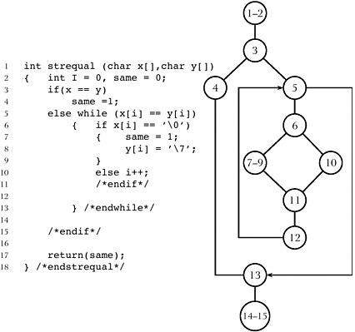
Cyclomatic Complexity Measures
E = 13, n = 11, cc = e – n + 2 = 13 – 11 + 2 = 4; Regions ➔ 4
Nilina Bera

Slide 9
State True or False for the following :
1. Software testing is the process of executing the program to find whether the program is error free or not.
Ans: True
2. When there is no communication gap between the developer and the requirements specified, test plan is required.
Ans: False
3. Black-box testing deals with the internal logic and structure of the code.
Ans: False
4. Test case is a set of conditions or variables used to determine whether an application or software system is working properly or not.
Ans: True
5. Clear box testing is another name for the white-box testing.
Ans: True
White-box testing (also known as clear box testing, glass box testing, transparent box testing, and structural testing) is a method of testing software that tests internal structures or workings of an application, as opposed to its functionality (i.e. black-box testing).
Nilina Bera

Slide 10
Nilina Bera

Slide 11
True or False
1. Boundary value analysis can only be used to do white-box testing.
Ans: False
2. In branch coverage, each edge in the control flow graph is traversed at least once during testing.
Ans: True
Multiple Choice Questions
Component testing is also known as:
a. Alpha testing b. Unit testing
c. Ad hoc testing d. Beta testing
Ans. b)
2. The deviation of the observed behavior to the specified behavior is called:
a. Error b. Fault
c. Failure d. Defect
Ans. c)
Nilina Bera

Slide 12
Error in testing
During the execution of a program, if any error is found, it implies that there is a difference between the actual output and the expected output of the program. Further extending error →
Fault: Refers to an incorrect process in computer program due to which the program performs in an unintended manner. Note that fault is the basic reason for software failure. Terms, bug and defect are also linked with it or it can be said that these are synonyms for fault.
Failure: Implies the deviation of the observed behavior from the specified behavior. The failure of the software can occur due to various factors, such as functional or performance factors.
Nilina Bera

Slide 13
Multiple Choice Questions
Acceptance testing is known as:
a. Black-box testing b. Automated testing
c. Grey box testing d. Beta testing
Ans. d)
2. Requirements specification, planning, test case design, execution, bug reporting and maintenance phases come under which life cycle?
a. SDLC b. SQLC
c. STLC d. BLC
Ans. c)
3. Black-box testing attempts to find errors in which of the following categories?
a. Incorrect or missing functions
b. Interface errors
c. Performance errors d. All the above
Ans. d)
Nilina Bera

Slide 14
Multiple Choice Questions
Which of the following is a part of system testing?
a. White-box testing b. Stress testing
c. Black-box testing d. Unit testing
Ans. b)
2. Which among the following is the testing performed to ensure that new features introduced in software do not affect the existing features?
a. Regression Testing b. Unit testing
c. Recursive testing d. White box testing
Ans. a)
3. Unit testing is done by:
a. End users
b. Developers
c. Customers d. Testers
Ans. b)
Nilina Bera

Slide 15
Fill in the blanks
Software testing is aimed at identifying any bugs,…………., ………., or …………. Present in the software.
A document that specifies the purpose, scope and method of software testing is known as …………………….
Two methods that enable the users to test the software are ………………. And …………………
………………. Is performed to test the program internal structure.
Errors, faults, failures
Test plan
Alpha testing, beta testing
White box testing
Nilina Bera

Slide 16
Multiple Choice Questions
Which of the following is a type of software testing strategy?
a. Dynamic b. Process-oriented
c. Model-based d. All of the above
Ans. d)
2. Which among the following is a type of control structure testing?
a. Data-flow Testing b. Loop testing
c. Both (a) and (b) d. None of the above
Ans. c)
3. Which of the following is not a step of debugging?
a. Defect analysis
b. Testing
c. Defect resolution d. Defect identification
Ans. b)
Nilina Bera

Slide 17
State True or False for the following :
1. Software testing activities need not be planned before testing commences.
Ans: False
2. While performing testing, there is no need to include test cases for invalid and unexpected conditions.
Ans: False
3. Testability is the ease with which the program is tested.
Ans: True
4. A set of all independent paths present in the program is known as basis set.
Ans: True
5. Debugging is performed prior to testing.
Ans: False
Nilina Bera

Slide 18
Descriptive Questions:
1. Is it beneficial to allow users to test the software before finally accepting it? If yes, why? Explain the testing through which the user tests the software.
2. Explain white box and black box testing techniques along with the differences between them.
3. What is the difference between equivalence class partitioning and boundary value analysis?
4. Which things should always be kept in mind while developing test cases for unit testing?
Nilina Bera

Slide 19
Descriptive Questions:
Consider the following code:
void foo (float y, float a*, int n)
{
float x = sin(y);
if (x > 0.01)
z = tan (x);
else
x = cos (x);
for (int i = 0; i < x; ++i) {
a[i] = a[i] * z;
cout << a[i];
}
cout << ‘function foo complete’;
}
Draw its flow graph, find its cyclomatic complexity and the independent paths.
Nilina Bera

Slide 20
Descriptive Questions:
We try to find out cyclomatic complexity (CC) by three methods:
cc = e – v + 2 = 8 – 7 + 2 = 3
cc = P + 1 = 2 + 1 = 3 ( P – predicate nodes with out-degree = 2, nodes 1 and 5 are predicate nodes)
cc = Number of enclosed regions + 1 = 2 + 1 = 3
Thus, cc = 3 is same by all three methods. By cc = 3 we mean that it is well written code, its testability is high and cost/effort to maintain is low.
Also, it means that there are 3 paths in this program which are independent paths and they form a basis-set. These paths are given below:
Path 1: 1 – 2 - 4 - 5 – 7
Path 2: 1 – 3 – 4 – 5 – 7
Path 3: 1 – 2 – 4 – 5 – 6 – 7
Another basis-set can also be formed:
Path 1: 1 – 2 - 4 - 5 – 7
Path 2: 1 – 3 – 4 – 5 – 7
Path 3: 1 – 3 – 4 – 5 – 6 – 7
This means that we must execu te these paths at least once in order to test the program thoroughly. So, test cases can be designed.
1
2
R1
3
4
R3
5
R2
6
7
Nilina Bera

